Slide 1
BRITISH AIRWAYS
Predictive modelling results

Slide 2
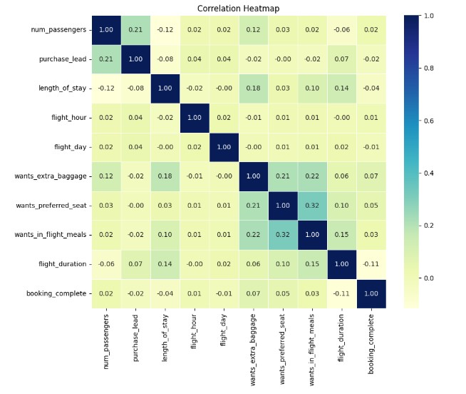
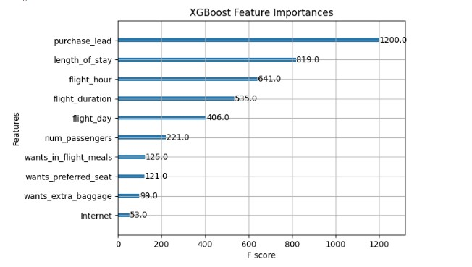
RESULTS
Model Accuracy
84.95%
In predicting successful bookings or unsuccessful bookings
Model Precision
37.86%
This is a weak score, as it shows where the model was correct in getting the successful bookings
The Correlation map shows us that the current features are not useful in predicting successful booking and even if the model does have high score using the best prediction model in the market.

